Slide 1
HarmonySphere API
A Music Feature & Insights Platform
WEB SERVICES AND WEB DATA – COURSEWORK 1 ORAL PRESENTATION
AUTHOR:[Yi Fanyu]
DATE:2026-04-21
Notes:
Good morning/afternoon. My name is [Yi Fanyu], and I will be presenting my coursework project, HarmonySphere API. This project is a music feature and insights platform developed as part of the XJCO3011 module. Let's begin.

Slide 2


Problem & Objectives
PROBLEM STATEMENT
Traditional music APIs often focus solely on metadata CRUD operations, lacking deeper, interpretable analysis of music features and user behavior.
PROJECT OBJECTIVES
Feature-Driven API:Centered around intrinsic music features (energy, danceability).
TRADITIONAL VS. HARMONYSPHERE
Behavior Tracking:Enable tracking of user interactions (listen, like, skip).
Core Focus
Metadata CRUD
Feature Analysis & Insights
Explainable Recs:Transparent engine based on Cosine Similarity.
Rec Engine
Black-Box Model
Transparent Cosine Sim
Preference Profiling:Generate user profiles with distribution analysis.
Output
Raw JSON Data
Production-Ready UI
Notes:
The core problem is that existing music APIs are limited to basic data management. They don't offer insights into why a user likes a song. My goal with HarmonySphere was to change that. I aimed to create a platform that not only manages music data but also analyzes it, tracks user behavior, and provides transparent recommendations and user profiles, all accessible through a professional frontend.

Slide 3
Coursework Requirement Mapping
SQL Database + CRUD Operations
Comprehensive API Documentation
SQLite db with `ListeningRecord` model supporting full CRUD via SQLAlchemy ORM.
Detailed Markdown docs (exportable to PDF) + interactive Swagger UI for real-time endpoint testing.
EVIDENCE: Code in database.py, models.py & routers/listening.py
EVIDENCE: docs/API_Documentation.md & /docs web endpoint
≥ 4 Functional API Endpoints
GitHub Version Control & README
Implemented 5 core groups: Auth, Tracks, Listening, Users & Analytics for comprehensive coverage.
Complete project history with atomic, meaningful commits and a detailed README with setup guide.
EVIDENCE: [Link to GitHub Repository] (Commit history & README.md)
Structured JSON & Status Codes
Technical Report & GenAI Statement
All responses return valid JSON payloads with correct HTTP codes (200, 400, 401, 404, 500).
EVIDENCE: Live API testing & Swagger response documentation
EVIDENCE: Accompanying PDF submission documents
Notes:
This slide demonstrates how my project meets all the mandatory requirements for this coursework. From implementing a SQL database with CRUD operations to providing comprehensive documentation and version control, every aspect has been carefully addressed. The 'Evidence' column points to where each requirement is fulfilled in the project.

Slide 4
Architecture & Stack Justification
System Architecture
Technology Stack
Security Layer
Tier 1: Frontend Pages
FastAPI Framework
API Key Auth
Core: HTML5 / CSS3 / JavaScript
High performance, auto docs, modern Python type hints.
Verifies server-to-server communication integrity.
SQLAlchemy ORM
Simplifies DB interactions, enhances code maintainability.
Tier 2: FastAPI Routers
Bearer Token (JWT)
Core: Python 3.10+ / Async Endpoints
SQLite Database
Secure user sessions & role-based access control.
Serverless, file-based, perfect for demo & development.
Tier 3: Data Layer(SQLAlchemy ORM → SQLite)
Uvicorn:ASGI runtime for FastAPI.
End-to-End Data Protection
Notes:
The system follows a clean three-tier architecture. The frontend serves the UI, FastAPI handles the core logic and API endpoints, and SQLAlchemy interacts with the SQLite database. I chose this stack for its lightweight nature, high development efficiency, and excellent documentation capabilities, which are crucial for a project of this scope and for easy demonstration.

Slide 5
Data Model Design
Core Entities
Relationships
Track Features
•AppUser:User credentials & base info
•AuthToken:Session & access tokens
•Track:Music metadata & features
•UserProfile:Preferences & settings
•ListeningRecordlinks toTrack via `track_id` foreign key
•ListeningRecordlinks toAppUser via `user_id` foreign key
•AuthTokenmaps toAppUser one-to-one user ownership
Core Metrics (Normalized 0-1): Energy, Danceability, Valence, Acousticness, Tempo, Popularity
Constraint:All features stored as strict floats between 0.0 and 1.0.
Notes:
The data model is designed to efficiently capture both music data and user interactions. The central entity is Track, which includes a rich set of acoustic features.
The ListeningRecord acts as a junction table, linking users to the tracks they interact with. This structure allows for powerful aggregation and analysis to generate user insights.

Slide 6
Core API Endpoints
Auth ( /v1/auth )
▍ Example API Request
POST /register | POST /login | GET /me Handles secure user authentication and profile management.
GET /v1/tracks/similar/123
Tracks ( /v1/tracks )
Headers: Authorization: Bearer {JWT_TOKEN} Purpose: Fetch songs similar to track ID 123.
GET /tracks | GET /features/{id} | GET /similar/{id} Access detailed track metadata and similarity recommendations.
▍ 200 OK Response (JSON)
Listening Records ( /v1/listening-records )
Full CRUD Operations (POST / GET / PUT / DELETE) Manage the complete history of user listening activity.
{
"track_id": 123,
"similar_tracks": [
{ "id": 456, "name": "Song A", "score": 0.92 },
{ "id": 789, "name": "Song B", "score": 0.87 }
]
}
Insights ( /v1/users/me/insights )
GET Request Only Retrieve AI-generated personalized preference profiles.
Analytics ( /v1/analytics/... )
Obtain global music feature distribution statistics.
Notes:
The API is organized into logical modules. The Auth module handles security, while Tracks and Listening manage the core data. The Insights and Analytics modules are where the value is added, providing personalized and global analysis. For example, a GET request to the similar tracks endpoint returns a list of songs ranked by their similarity score, as shown in the example.

Slide 7

Similarity & Insight Logic (High Score Point)
01. Similarity Calculation
Method: Cosine Similarity (Vector Dot Product). Formula:cos(θ) = (A · B) / (||A|| ||B||) Process: Extract track vectors & find closest matches in dataset.
02. User Preference Profile
Method: Aggregation of Listening Records. Process: Calculates avg.Tempo,Energy&Danceabilityfrom liked tracks to build an interpretable profile.
Intelligence Processing Flow
03. Core System Advantage
Logic isinterpretable, reproducible & low-latency. Avoids the "black box" nature of complex LLMs.
User Action
Data Agg.
Analysis
Notes:
This slide explains the core logic behind the platform's intelligence. Similarity is calculated using cosine similarity, a well-known and interpretable mathematical method, ensuring transparency. User insights are generated by aggregating their listening history to create a clear profile of their preferences. A key design choice was to avoid complex AI models, making the system's decisions explainable and fast.

Slide 8
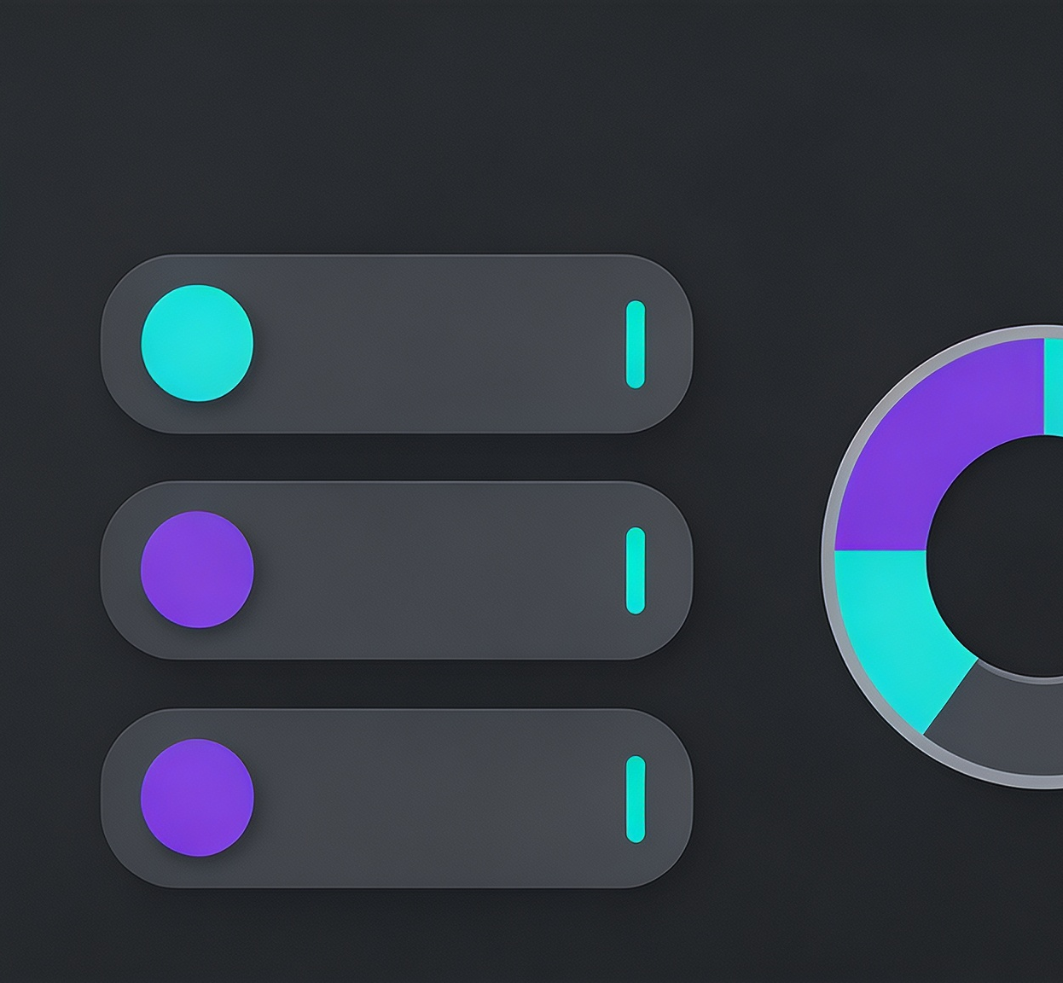
Product-oriented Frontend
USER JOURNEY
Login Secure user authentication
Home Landing page & main nav
Discover Browse full music catalog
Favorites Manage liked song list
KEY FEATURES
Dynamic Cards Visually rich list browsing
Instant Feedback Toast alerts on Like/Skip
Deep Track Insights Audio features & recs
Profile Visualization Personal preference radar
Notes:
To make the API tangible, I developed a product-oriented frontend. Users can register, log in, browse tracks, and save their favorites. Most importantly, they can visit the Insights page to see their personalized music profile and recommendations. This frontend proves the API's functionality and usability beyond just raw data endpoints.

Slide 9
Quality Assurance & Compliance
Rigorous Manual Testing
Semantic Error Handling
Validated all critical user flows (Auth, Favorites, Profile) and verified correct JSON responses & status codes for both valid/invalid API requests.
Implemented descriptive HTTP status codes: 400 (Bad Input), 401 (Auth Fail), 404 (Missing Res), 409 (Conflict), 422 (Validation Error).
GitHub Version Control
GenAI Assistance Policy
Maintained a clean, logical commit history with atomic commits grouped by feature implementation for full traceability.
Used for brainstorming & debug suggestions only. All core logic, code implementation, and final QA were completed personally.
Notes:
I ensured the quality and robustness of the project through several measures. I performed thorough manual testing, implemented descriptive error handling, and maintained a clean version control history. I also want to be transparent about my use of GenAI, which served as a tool for assistance but did not replace my own understanding and work on the project.

Slide 10

Conclusion & Future Work
KEY ACHIEVEMENTS
KNOWN LIMITATIONS
NEXT STEPS
• Delivered a full CRUD database-driven API
• Implemented secure auth & authorization
• Provided song similarity & profiling tools
• Attached product-oriented React frontend
• Spotify integration is manual (no auto-import)
• Password hashing uses a basic scheme
• Lack of automated test suites
• Limited error handling for edge cases
• Implement JWT refresh token mechanism
• Build real-time Spotify search & recommendation
• Add visualizations for recommendation logic
• Deploy to cloud (AWS/GCP) with CI/CD
Q&A
Notes:
In conclusion, HarmonySphere successfully achieves its objectives, providing a functional, secure, and insightful music platform. While there are limitations, such as the manual Spotify integration and room for improved testing, the project provides a solid foundation. For the future, I would focus on enhancing security, automating data import, and deploying the application to the cloud. Thank you for your attention. I am now ready to answer any questions.

